Slide 1


DEPARTMENT OF ECE
ECB1212-DESIGN THINKING
II year /III Sem
TITLE : AIR QUALITY MONITORING INSIDE THE HOSPITAL
NICKSON JIMS J (8115U24EC066)
1

Slide 2

Contents
Introduction
Identifying the problem
Problem Statement Analysis Model
Existing System
Proposed System
Block Diagram
Cost Estimation
Working principle
Key component
Conclusion

Slide 3

AIR QUALITY MONITORING IN HOSPITAL
Introduction
Indoor air quality plays a vital role in ensuring the wellbeing of patients, doctors, and staff in hospitals.
Exposure to harmful gases, dust particles, and pathogens can lead to infections, allergies, and slower recovery rates.
When unsafe levels are detected, the system provides instant alerts and can trigger ventilation or purification mechanisms.
The design is reliable, cost-effective, and scalable, making it suitable for modern smart healthcare environments.
.

Slide 4

Identifying the Problem
Invisible Pollutants: Many harmful gases and fine particles are invisible, making them difficult to detect without sensors.
Manual Monitoring: Relying on staff for air checks is impractical and often inaccurate.
Delayed Detection: Current systems may not provide real-time alerts, leading to higher infection risks.
Lack of IoT Integration: Existing setups often miss remote monitoring and data analysis features.
Patient Safety Concerns: Poor air quality directly affects recovery, immunity, and overall wellbeing.

Slide 5
Problem Statement Analysis Model
1. Problem Identification
Poor indoor air quality in hospitals due to high CO₂ concentration, particulate matter, humidity imbalance, and inadequate ventilation.Traditional air quality monitoring methods rely on manual inspection, which is not continuous and often delayed.
2. Root Cause Analysis
Lack of real-time air quality monitoring systems inside hospitals.
Absence of automated alerts for early detection of harmful air quality.
Limited integration of IoT-based remote monitoring in healthcare facilities.
3. Proposed Solution
Implementation of an IoT-based air quality monitoring system using sensors (CO₂, PM2.5/PM10, humidity, temperature).
Integration with ESP8266 and Blynk app for real-time monitoring and remote alerts.
Alarm and LCD display system for immediate awareness and corrective actions.

Slide 6
Existing system
Hospitals currently rely on manual inspection methods or standalone air quality meters for checking indoor air quality.
Monitoring is usually done periodically (not continuous), leading to delays in detecting harmful conditions.
Data is not stored or transmitted remotely, making it difficult for staff to track air quality trends over time.
There is no automatic alert system; staff must physically check readings to know when air quality is unsafe.
Existing solutions are often expensive, bulky, or limited to single-parameter measurement (like only CO₂ or only humidity).
Lack of integration with IoT and smartphones restricts timely action in critical hospital zones such as ICUs and operation theatres.
.

Slide 7

Proposed System
Continuous Air Quality Monitoring Monitors CO₂, particulate matter (PM2.5/PM10), temperature, and humidity in real time.
IoT Integration ESP8266 sends live data to the Blynk app or hospital dashboard for remote monitoring.
Advanced Alert Mechanism Triggers alarms, buzzer, and smartphone notifications when values exceed safe limits.
User-Friendly Design Compact, low-cost, and easy to install in ICUs, wards, and operation theaters.
Enhanced Safety Ensures clean air, reduces infection risks, and supports a healthy environment for patients and staff.
.

Slide 8
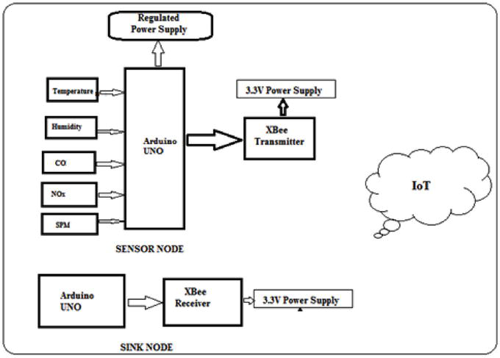
Block diagram

Slide 9
Working Principle
Air Quality Monitoring The air quality sensor continuously measures parameters such as CO₂ levels, temperature, humidity, and particulate matter (PM2.5/PM10) inside the hospital.
Signal Processing When air quality values exceed the safety threshold, the sensor sends signals to the microcontroller for analysis.
Alert Activation The system triggers alarms and displays the air quality index (AQI) and specific parameter levels on the LCD screen for staff awareness.
IoT Integration The ESP8266 module transmits real-time data to the Blynk app (or hospital monitoring dashboard), enabling remote supervision.
User Notification Healthcare staff receive instant alerts on their smartphones to take corrective measures, such as activating air purifiers or ventilation systems.

Slide 10
Components with Cost Estimation
Components | Cost (₹)
Air Quality Sensor (MQ-135 for CO₂, NH₃, Benzene, Smoke etc.) | 200 – 300
Dust/Particulate Matter Sensor (PM2.5/PM10, e.g., SDS011/GP2Y1010AU0F) | 800 – 1,200
Temperature & Humidity Sensor (DHT11/DHT22) | 100 – 200
Microcontroller (Arduino UNO) | 400 – 600
LCD Display (16x2 or 20x4) | 200 – 300
Wi-Fi Module (ESP8266/ESP32 for data logging) | 300 – 500
Power Supply | 150
Total | ₹ 2,200 – 3,200

Slide 11
Key Components
1. Air Quality Sensors Detects CO₂ concentration, particulate matter (PM2.5/PM10), temperature, and humidity levels inside the hospital.
2. ESP8266 Module A Wi-Fi-enabled microcontroller that processes sensor data and enables IoT connectivity for real-time monitoring.
3. LCD Display Shows the Air Quality Index (AQI) and parameter readings (CO₂, PM, temperature, humidity) for local staff awareness.
4. Blynk App / Hospital Dashboard Allows remote monitoring of air quality data and sends alerts to healthcare staff smartphones.
5. Power Supply Provides stable and uninterrupted power for continuous monitoring and system reliability.

Slide 12
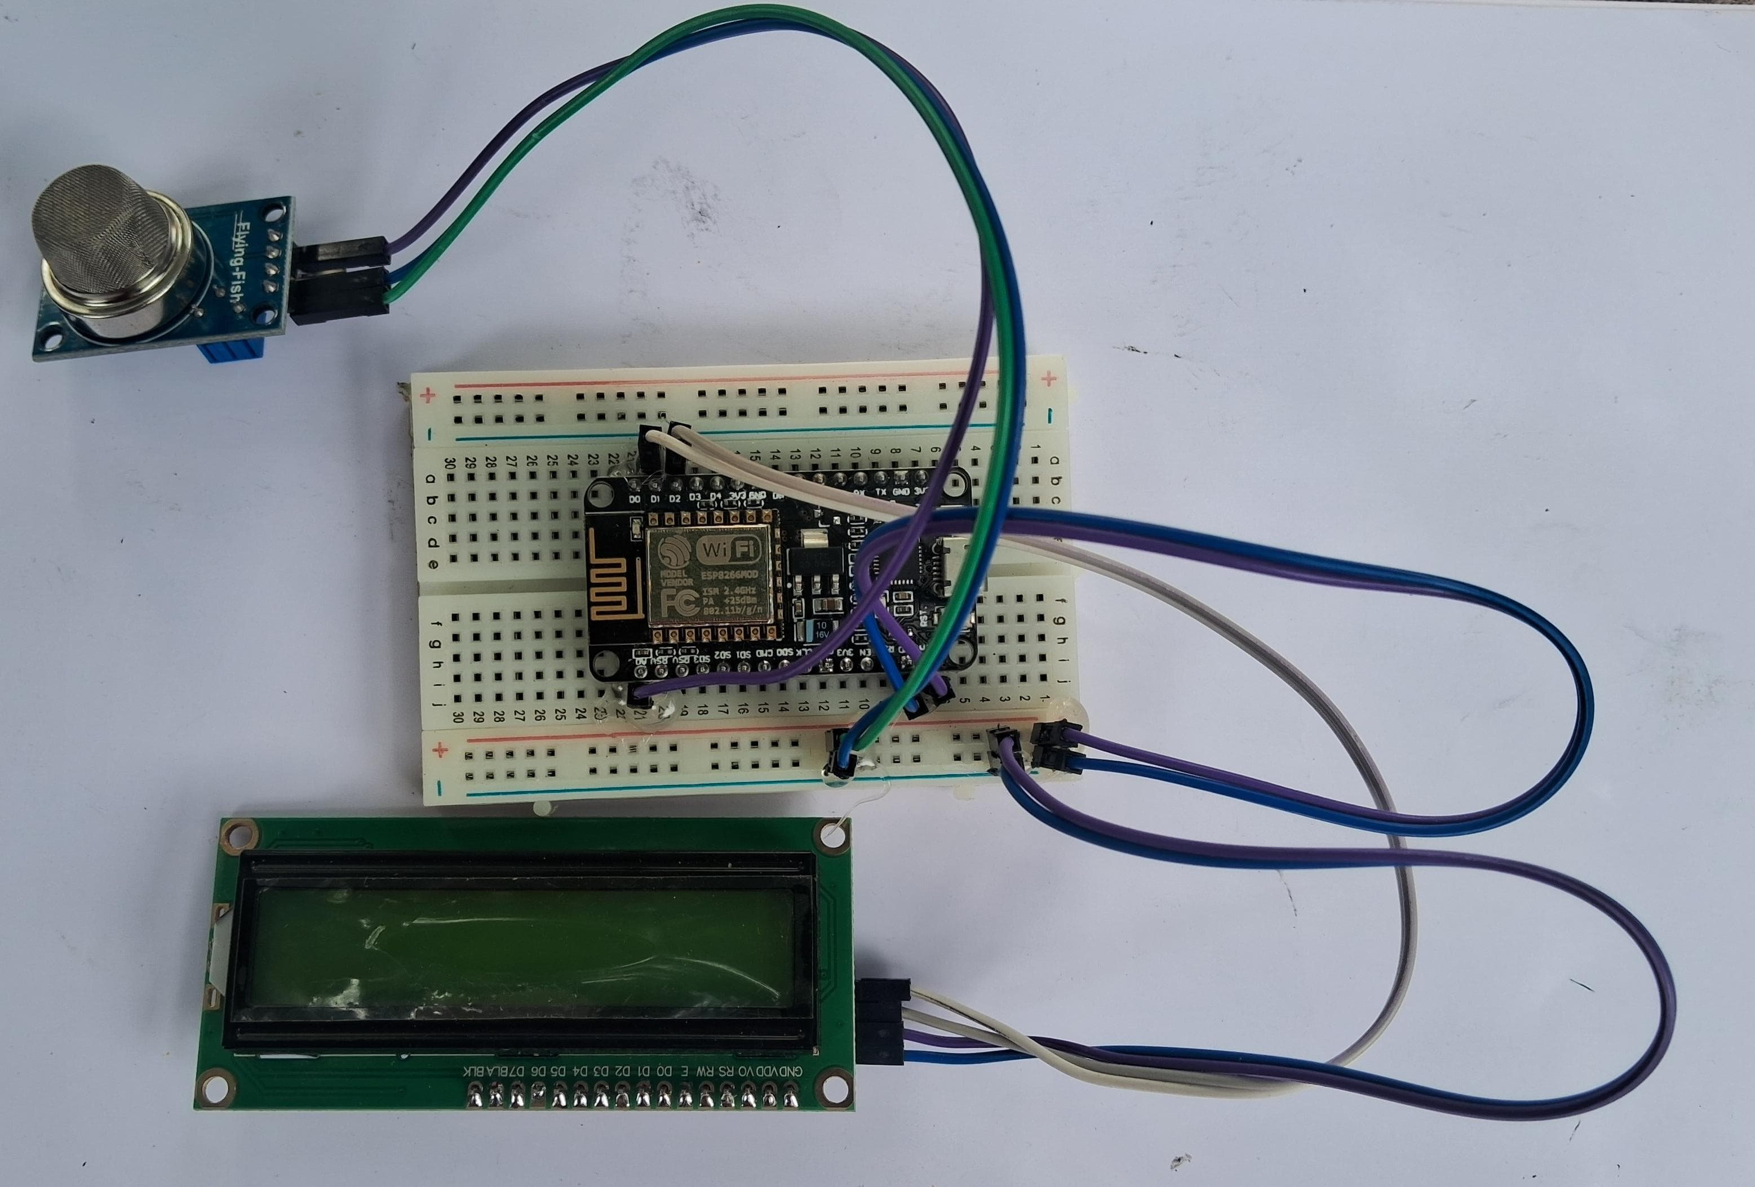
Working Model

Slide 13
Conclusion
The Hospital Air Quality Monitoring System is a reliable and efficient solution for maintaining a healthy indoor environment in healthcare facilities. By integrating real-time monitoring, IoT connectivity, and instant alert mechanisms, the system ensures early detection of harmful pollutants. Its compact design, affordability, and scalability make it suitable for ICUs, operation theaters, and general wards. This project demonstrates how technology can improve patient recovery, staff safety, and overall hospital hygiene.

Slide 14


